Slide 1

Social Media App
Bhavna Rana

Slide 2
Problem Statement/Functional Requirements
Design a comments service for a social media website which can support scalable levels of nesting.
The service should return n first level comments.
On clicking on view replies, the next level of comments should be fetched.
All the comments have associated likes and dislikes.
On clicking on the likes or dislikes the list of the users participating in the like/dislike shall be displayed

Slide 3
Assumptions & Limitations
The maximum size of a post, or a reply can be 2500 characters
All posts and replies are of type text only. Multimedia is not supported
Deletion of comments and replies is not supported
For creating a new post, or a comment, idempotency is not guaranteed

Slide 4
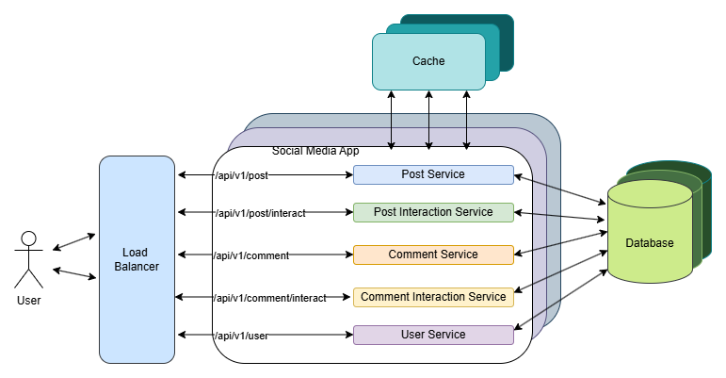
High-level Design

Slide 5
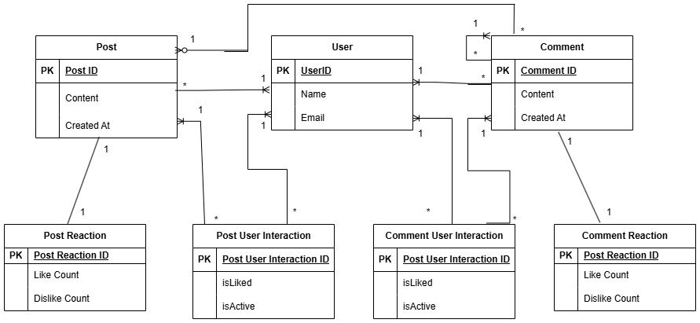
ER Diagram

Slide 6
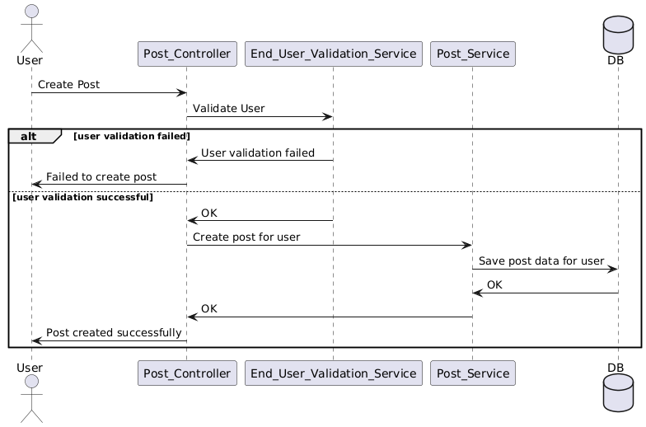
Low-level Design (Create Post Sequence Diagram)

Slide 7
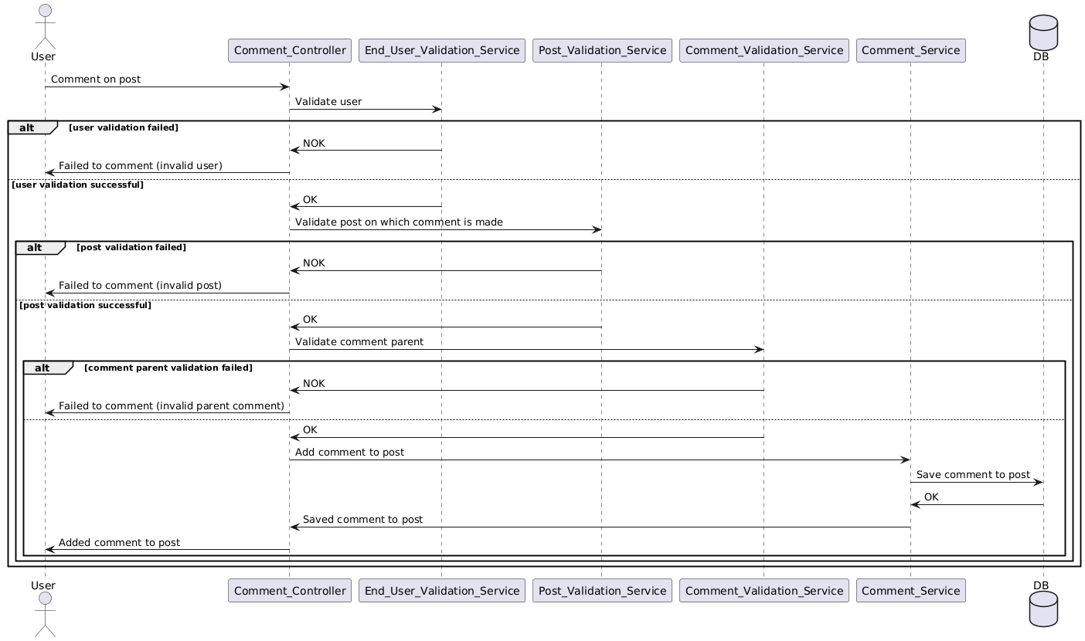
Low-level Design (Create Comment Sequence Diagram)

Slide 8
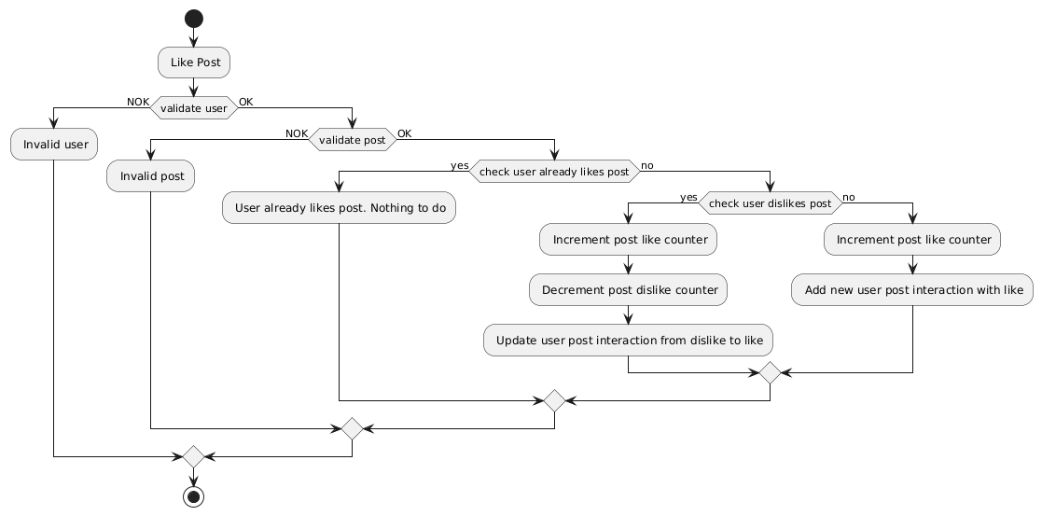
Low-level Design (Like Post Activity Diagram)

Slide 9




UX (User Feed)
Anushka's Feed
Smriti Mandhana 15 minutes ago Heyyyoooo!!! We won!!! We did it!!! We won the IPL
500
2
Reply
Edit
Meg Lanning 16 minutes ago A tough night, but proud of the girls. Congrats RCB
Reply
240
20
Edit
Mr Nags 30 minutes ago And it's the women who do it!!! Let the celebrations begin!!! Boys, you have your task cut out!!!
950
2
Reply
Edit
Virat Kohli 35 minutes ago Smriti & Co, I am so proud of you. Winning from a tough spot is never easy!
Reply
4826
2
Edit
...View more posts

Slide 10
UX (Replies on a post)
Anushka's Feed
Smriti Mandhana 15 minutes ago Heyyyoooo!!! We won!!! We did it!!! We won the IPL
500
2
Reply
Edit
Meg Lanning 2 minutes ago Congratulations, it was a match to remember
50
2
Reply
Edit
AB De Villiers 3 minutes ago Congratulations, girls! We were rooting for you
321
2
Reply
Edit
Virat Kohli 5 minutes ago Cherish the moment. The streets of Bengaluru will never forget you!
982
2
Reply
Edit
...View more replies

Slide 11
List of APIs

Slide 12
Demo

Slide 13
Questions?!

